Slide 1
DSP C5000
Chapter 22
Implementation of Viterbi Algorithm/Convolutional Coding
Copyright © 2003 Texas Instruments. All rights reserved.

Slide 2
Objectives
Explain the Viterbi Algorithm
  E.g.: detection of sequence of symbols
Example of application on the GSM convolutional coding
Present its implementation on the C54x
  Specific hardware
  Specific instructions

Slide 3
Viterbi Algorithm (VA)
Dynamic programming
Finds the most likely state transitions in a state diagram, given a noisy sequence of symbols or an observed signal.
Applications in
  Digital communications:
    Channel equalization, Detection of sequence of symbols
    Decoding of convolutional codes
  Speech recognition (HMM)
Viterbi can be applied when the problem can be formulated by a Markov chain.
Notes:
Here HMM means Hidden Markov Model

Slide 4
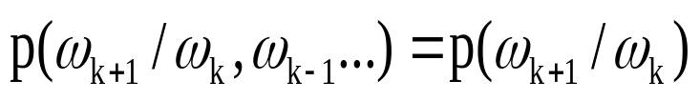
Markov Chain
Markov process ω_{k}:
If values of ω_{k} form a countable set, it is a Markov chain.
  ω_{k} state of the Markov chain at time k

Slide 5
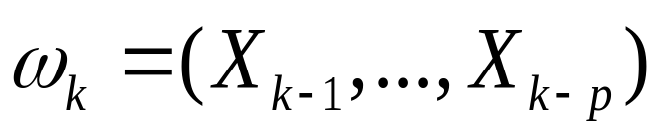

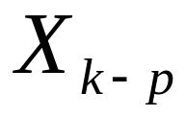
Example of Markov Process
X_{k} is independent of X_{k-i}, i=1 to p+1.
If X_{k} values belong to a countable set, it is a Markov chain.

Slide 6



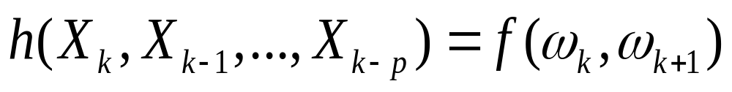
Signal Generator Markov Chain
The signal S_{k} depends on the transitions of a Markov chain ω_{k}.

Slide 7
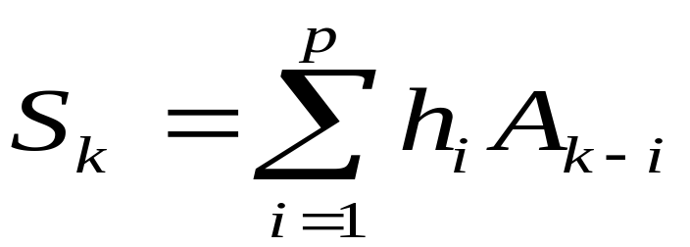
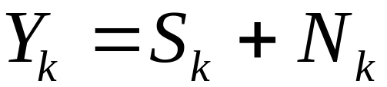
Example: Detection of a Sequence of Symbols in Noise
Sk
Ak
hk
Yk
Emitted symbols
Observed noisy sequence
Equivalent Discrete model of the channel
Nk
Noise
The problem of the detection of a sequence of symbols is to find the best state sequence for a given sequence of observations Yk with k in the interval [1,K].
Sk is a signal generated by a Markov chain

Slide 8
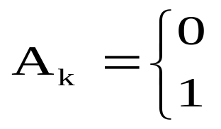

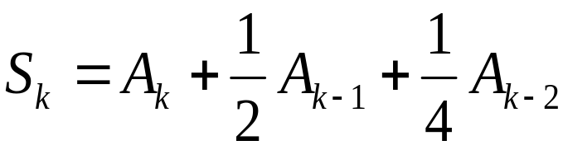
Example: Detection of a Sequence of Symbols in Noise
Suppose:
Observed sequence Y_{k} = 0.2, 0.7, 1.6, 1.2
Possible values for non-noisy outputs
Sk = 1.75, 1.50, 1.25, 0.75, 1.00, 0.50, 0.25, 0.00
Notes:
The possible values of S_{k} are obtained by replacing A_{k} with the 2 values 0 or 1 in the equation:
S_{k} = A_{k} + ½ A_{k-1} + ¼ A_{k-2}
For example, if A_{k} = 1, A_{k-1} = 0 and A_{k-2} = 1
S_{k} = A_{k} + ½ A_{k-1} + ¼ A_{k-2} = 1.25

Slide 9
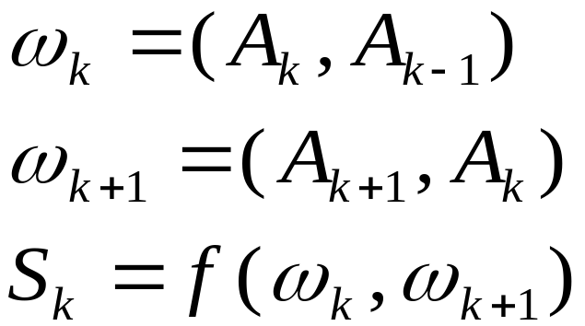
Example: Detection of a Sequence of Symbols in Noise
There are 4 states in the Markov chain.
The transition between the different states can be represented by a State Diagram, or by a Trellis.

Slide 10

Example: Detection of a Sequence of Symbols in Noise, State Diagram
(0,0)
11
(1,1.75)
00
(1,1)
(0,0.75)
(0,0.25)
(1,1.5)
(1,1.25)
10
01
(0,0.5)
= state
= (input, output)
Notes:
The different states are associated with the pairs of values of the 2 last bits: (A_{k-1}, A_{k-2}).
So there are 4 different states.
The transitions between states depend on the new bit A_{k} and on the original state (A_{k-1}, A_{k-2}).
The values in brackets on the branches represent the input bit A_{k} and the resulting output S_{k}.
For example, when starting from state 00 (top left) and sending a new bit A_{k} = 1,
there is a transition towards the state 10 and the output Sk is equal to:
S_{k} = A_{k} + ½ A_{k-1} + ¼ A_{k-2} = 1 + 0 +0 = 1.
So the values in brackets associated to this transition branch are: (1,1) since A_{k}=1 and S_{k}=1.

Slide 11
Example: Detection of a Sequence of Symbols in Noise, Trellis Representation
k=0
k=1
k=2
k=3
k=4
k=5
k=K-2
k=K-1
k=K
Hypothesis: initial condition = state 00, final condition = state 00
Trellis with 4 states: (0,0) (0,1) (1,0) (1,1)
Notes:
The trellis represents the possible stats and transitions between states with time k.
Each purple circle represents a state (A_{k-1}, A_{k-2}). On the drawing, we supposed that the states are ordered
With state (00) on top then state (01), then (10) and (11) at the bottom.
After the initialization stages, there are 4 possible states at each time and 2 possible transitions from each stage depending on, the bit A_{k}.

Slide 12
Example: 1 Stage of the Trellis
Time:
k
Ak/Sk
k+1
States:
(A_{k-1}, A_{k-2})
0/0
(0,0)
(0,0)
1/1
0/0.25
(0,1)
(0,1)
1/0.75
0/0.5
(1,0)
(1,0)
1/1.25
0/0.75
1/1.75
(1,1)
(1,1)
Notes:
This figure represents one stage of the Trellis.
The purple circles represent the different states.
Here there are 4 states corresponding to the 4 possible values of the pair (A_{k-1},A_{k-2}).
The yellow values on the branches represent:
for the first one, the value of the emitted bit A_{k} for this transition
for the second one, the value of the filter output S_{k}.

Slide 13
Example: Detection of a Sequence of Symbols
Each path in the trellis corresponds to an input sequence Ak.
From the sequence of observations Yk, the receiver must choose among all the possible paths of the trellis, the path that best corresponds to the Yk for a given criterion.
To choose a path in the trellis, is equivalent to choose a sequence of states ω_{k}, or of A_{k} or of S_{k}.
We suppose that the criterion is a quadratic distance.

Slide 14
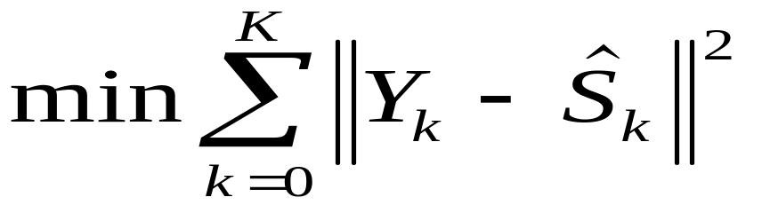
Example: Detection of a Sequence of Symbols
Choose the sequence that minimizes the total distance:
The number of possible paths of length K in a trellis increases as M^{K}, where M is the number of states.
The Viterbi algorithm allows to solve the problem with a complexity proportional to K (not proportional to M^{K}).
It is derived from dynamic programming techniques (Bellman, Omura, Forney, Viterbi).

Slide 15
Viterbi Algorithm, Basic Concept
Let us consider the binary case:
  2 branches arrive at each node
  2 branches leave each node
  All the paths going through 1 node use one of the 4 possible paths.
If the best path goes through one node, it will arrive by the better of the 2 arriving branches.

Slide 16
Viterbi Algorithm, Basic Concept
The receiver keeps only one path, among all the possible paths at the left of one node.
  This best path is called the survivor.
For each node the receiver stores at time k:
  the cumulated distance from the origin to this node
  the number of the surviving branch.
?
?
k-1
k

Slide 17
Viterbi Algorithm: 2 Steps 1 of 3
There are 2 steps in the Viterbi algorithm
  A left to right step from k=1 to k=K in which the distance calculations are done
  Then a right to left step called traceback that simply reads back the results from the trellis.

Slide 18
Viterbi Algorithm: 2 steps 2 of 3
The left to right step from k=1 to k=K:
  For each stage k and each node, calculate the cumulated distance D for all the branches arriving at this node.
  Distance calculations are done recursively:
      The cumulated distance at time k for a node i: D(k,i) reached by 2 branches coming from nodes m and n is the minimum of:
      D(k-1,n) + d(n,i)
      D(k-1,m) + d(m,i)
      Where d(n,i) is the local distance on the branch from node n at time k-1 to node i at time k.
      d(n,i)=(Yk-Sk(n,i))² where Sk(n,i) is the output when going from node n to node i.
m
i
?
?
n
k-1
k

Slide 19
Viterbi Algorithm: 2 steps 3 of 3
At the end of the first step:
  The receiver has an array of size KxM containing for each node at each stage the number of the survivor,
  and the set of values=cumulated distances from the origin to each node of the last stage.
The second step is called traceback.
  It is simply the reading of the best path from the right to the left of the trellis.
  The best path arrives at the best final node, so we just have to start from it and read the array of survivors from node to node until the origin is reached.

Slide 20
Application of Viterbi Algorithm to the Example of Sequence Detection
Hypothesis: start from state 0
k=0
k=1
0.04
0.04
0.64
0.64
Y1=0.2
Local distances are written in green
Cumulative distances are written in orange.
Yk are written in blue.

Slide 21
Application of Viterbi Algorithm to the Example of Sequence Detection
k=0
k=1
k=2
0.04
0.49
0.53
0.64
0.09
0.68
0.04
0.13
0.64
1.28
0.2
0.7
There is survivor choice to be made during this initialization step.

Slide 22
Application of Viterbi Algorithm to the Example of Sequence Detection
First survivor choice
2.56
2.5025=min( 0.53+2.56,
0.68+1.8225)
0.04
0.53
0.36
1.8225
0.68
1.34=min( 0.13+1.21,
1.28+0.7225)
0.1225
1.21
0.64
0.13
0.01
0.8025=min( 0.53+0.36,
0.68+0.1225)
0.7225
1.28
0.0225
0.14=min( 0.13+0.01,
1.28+0.0225)
0.2
0.7
1.6

Slide 23
Application of Viterbi Algorithm to the Example of Sequence Detection
Selection of survivors
0.04
0.53
2.5025
0.68
1.34
0.64
0.13
0.8025
0.14

Slide 24
Application of Viterbi Algorithm to the Example of Sequence Detection
Next stage from k= 3 to k=4
2.5025
1.44
2.265
0.04
0.925
1.34
0.3425
0.0025
0.49
0.8025
1.3425
0.09
0.2025
0.3025
0.4425
0.14
1.6
1.2

Slide 25
Application of Viterbi Algorithm to the Example of Sequence Detection
Traceback
2.265
'0'
'1'
'1'
'0'
0.3425
1.3425
0.4425
Best path in yellow

Slide 26
Convolutional Coding (GSM Example)
G0
+
input bit
Stream b
output bit
Stream:
2 output bits
for 1 input bit
z⁻¹
z⁻¹
z⁻¹
z⁻¹
+
G1
K = Constraint Length = 5
G0(D) = 1 + D³ + D⁴
G1(D) = 1 + D + D³ + D⁴
noted in octal 23 and 33
R = Coding Rate = 0.5
Notes:
There are different families of error correcting codes, in particular block codes and convolutional codes.
Block codes transform the incoming symbol block per block. The redundancy added by the block code only depends on one block.
Convolutional codes work more or less as filters. The added redundancy depends on the incoming symbol and on the memory of the system.

Slide 27
Convolutional Coding (GSM Example)
Time t
Time t+1
b3
b2
b1
0
0
b3
b2
b1
State 2J
State J
b3
b2
b1
1
1
b3
b2
b1
State 2J+1
State J+8

Slide 28
Convolutional Coding (GSM Example)
k=0
k=1
k=2
k=3
2J = b
b
b
0
J = 0 b
3
b
2
b
1
3
2
1
2J+1 = b
3
b
2
b
1
1
J+8 = 1 b
b
b
3
2
1

Slide 29
Convolutional Decoding
Hard or Soft Decision
Hard decision: data represented by a single bit => Hamming distance
Soft decision: data represented by several bits => Euclidian or probabilistic distance
  Example 3 bits quantized values
    011=most confidence value 111=less conf. neg. value
    010 110
    001 101
    000=Less conf. pos. value 100=most conf. neg. val.
For the GSM coding example, at each new step n, the receiver receives 2 hard or soft values.
  Soft decision values will be noted SD₀ and SD₁
Notes:
The Hamming distance between 2 sets of binary values is the number of different bits.
For example, the Hamming distance between the 2 tribits (0 1 0) and (1 1 1) is equal to 2. There are 2 bits which are different.
The Hamming distance between between (1 0 0) and ( 0 0 0) is equal to 1. There is only one bit difference.
For the soft decision case, the output of the adapted filter is quantified on a small number of bits in order to indicate how close it is
to the 2 possible theoretical values -1 and 1.
The expression “most or less confidence value” indicates the probability that the received sample corresponds to a 0 or a 1.

Slide 30
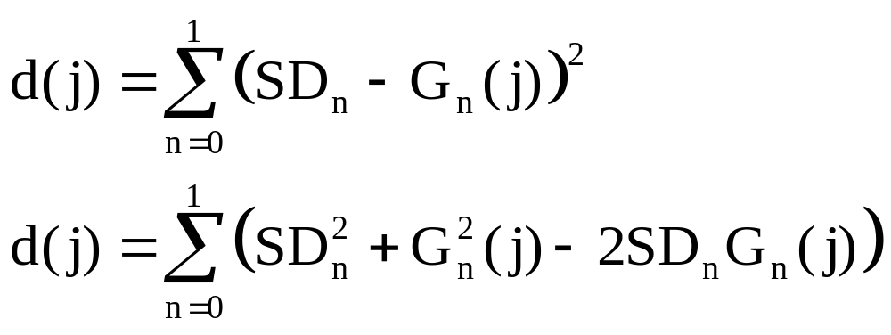
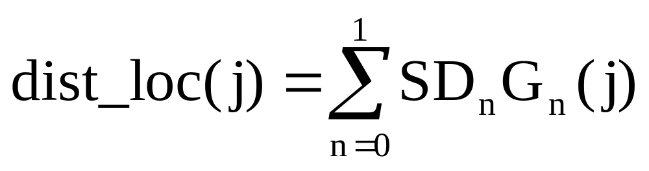
Evaluation of the Local Distance for Soft Decoding with R=0.5
SD_{n} = soft decision value
G_{n}(j) = expected bit value

Slide 31
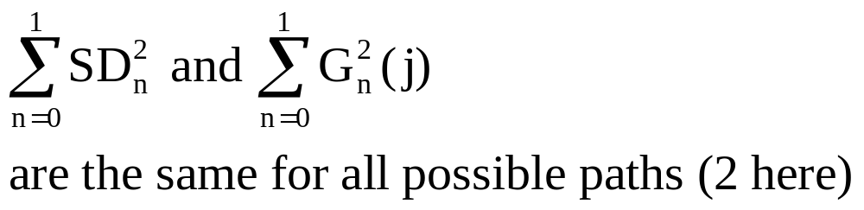
Evaluation of the Local Distance for Soft Decoding (cont.)

Slide 32
Evaluation of the Local Distance for Soft Decoding R=0.5
dist_loc(j)=SD₀G₀(j)+SD₁G₁(j)
4 possible values (2^{1/R}) :
    d = SD₀ + SD₁
    d’ = SD₀ - SD₁
    - d
    - d’
Use of symmetry
  Only 2 distances are calculated
  Paths leading to the same state are complementary
Maximize distance instead of minimize because of the minus sign.

Slide 33
Calculation of Accumulated Distances using Butterfly Structure
One butterfly: 2 starting and ending states (joined by the paths) are paired in a butterfly.
  For R=0.5 , state 2J and 2J+1 with J and J+8
Symmetry is used to simplify calculations
  One local_distance per butterfly is used
  Old possible metric values are the same for both new states => minimum address manipulations

Slide 34
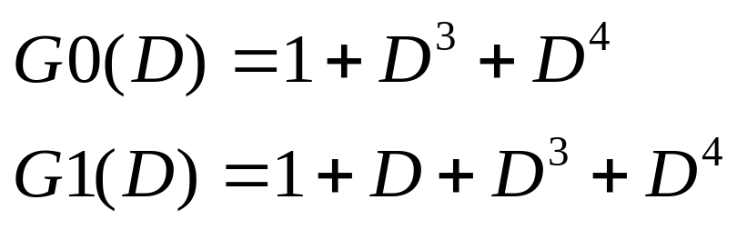
Butterfly Structure of the Trellis Diagram, GSM Example
Old state
New state
Local distance d
2J
J
-d
-d
2J+1
J+8
d
Soft decision values: SD0, SD1

Slide 35
Implementation on C54x
To implement the Viterbi algorithm on C54x we need:
  Compare store and Select Unit
  One Accumulator
  Specific instructions
    DADST
      Double-Precision Load With T Add or
      Dual 16-Bit Load With T Add/Subtract)
    DSADT
      Long-Word Load With T Add or
      Dual 16-Bit Load With T Subtract/Add)
    CMPS (Compare Select Store)

Slide 36
CSSU Compare Store and Select Unit
DB [15:0]
CB [15:0]
Dual 16-bit
ALU operations
T
T register input
ALU as dual
16-bit operand
AH AL
BH BL
32
16-bit transition
shift register
(TRN)
C16=1
ALU
MSB/LSB
One cycle store
Max and Shift
decision
WRITE
SELECT
CSS UNIT
COMP
16
=MUX
TRN
TC
EB [15:0]
Notes:
The CSS Unit contains a comparator COMP and a 16-bit Transition register TRN.
It works in connection with the ALU.
For Viterbi algorithm operations, the 32 bit ALU is split into two 16 bit ALUs in order to calculate 2 distances at a time.

Slide 37
Structure of Viterbi Decoding Program
Initialization
Metric update
  In one symbol interval:
    8 butterflies yield 16 new states.
  This operation repeats over a number of symbol time intervals
Traceback

Slide 38
Viterbi Instructions CMPS, DADST, DSADT
C16 = 1
DADST Lmem,dst
Lmem ( 31-16 ) + (T) ➔ dst (39-16)
Lmem ( 15 - 0 ) - (T) ➔ dst (15 - 0)
DSADT Lmem,dst
Lmem ( 31-16 ) - (T) ➔ dst (39-16)
Lmem ( 15 - 0 ) + (T) ➔ dst (15 - 0)
CMPS src, Smem
IF { [ src (31-16) ] > [ src (15-0) ] }
THEN :
(src(31-16)) ➔ Smem
0 ➔ TC
(TRN << 1 ) + 0 ➔ TRN
ELSE :
(src(15-0)) ➔ Smem
1 ➔ TC
(TRN << 1 ) + 1 ➔ TRN

Slide 39
DADST, DSADT
DSADT Lmem, dst; Lmem 32-bit operand
  C16=1, ALU dual 16-bit operations, 2 additions or subtractions in 1 cycle
  C16=0, ALU standard mode, single operation double precision
C16=1
  1 addition and 1 subtraction using the T register
C16=0, not of interest for Viterbi
  DADST: dst=Lmem + (T+T<<16)
  DSADT: dst=Lmem - (T+T<<16)

Slide 40
Viterbi Algorithm (VA) Initialization
Processing mode
  SXM = 1
  C16 =1 (Dual 16 bits Accumulator)
Buffer pointers
  Input, output buffers, transition table, Metric storage (circular buffer set and enabled)
Initialization of metric values
Block repeat counter = number of output bits -1

Slide 41
VA Initialization (cont.)
FR = Frame length in coded bits
Input buffer size = FR/R
Output buffer size = FS (packed in FS/16)
Transition table size = 2^{K-1}FS/16
Metric storage = 2 buffers of size 2^{K-1} configured in one circular buffer:
  Buffer size 2 x 2^{K-1}. Register BK initialized at 2 x 2^{K-1}
  index pointer AR0= 2^{K-2} + 1
All states except starting one 0 are set to the same metric value 8000h

Slide 42
VA Metric Update
Loop for all Symbol Intervals
Calculate local distance between input and each possible path. For R=0.5, only 2 values
  LD *AR1+,16,A ;A=SD0(2i)
  SUB *AR1,16,A,B ;B=SD0(2i)-SD1(2i+1)
  STH B,*AR2+ ;tmp(0)=difference
  ADD *AR1+,16,A,B ;B=SD0(2i)+SD1(2i+1)
  STH B,*AR2 ;tmp(1)=sum

Slide 43
VA Metric Update (cont.)
Accumulate total distance for each state
  Using the split ALU, the C54x accumulates metrics for 2 paths in 1 cycle (if local dist in T) with DADST and DSADT.
Select and save minimum distance
Save indication of chosen path
  The 2 last steps can be done in one cycle using CMPS (Compare Select Store) on the CSSU.

Slide 44
CMPS Instruction
Compare the 2 16-bit signed values in the upper and lower part of ACCU
Store the maximum in memory
Indicate the maximum by setting TC and shifting this TC value in the transition register TRN.
Notes:
TC = Test and Control bit that is set or reset by test instructions.
TRN = TRaNsition register. It is A 16 bit shit register. It is used to store at each time and for each arriving node, what is the survivor branch.
It has to be stored in data memory every 16 time instants.
These stored results are examined during the traceback step.

Slide 45
VA Metric Update use of Buffers
Old metrics accessed in consecutive order
  One pointer for addressing 2^{K-1} words.
New metric accessed in order :
  0, 2^{K-2}, 1, 2^{K-2}+1, 2, 2^{K-2}+2 ...
  2 pointers for addressing.
At the end, both buffers are swapped
The transition register TRN (16bits) must be saved every 8 butterflies (2 bits per butterfly).

Slide 46
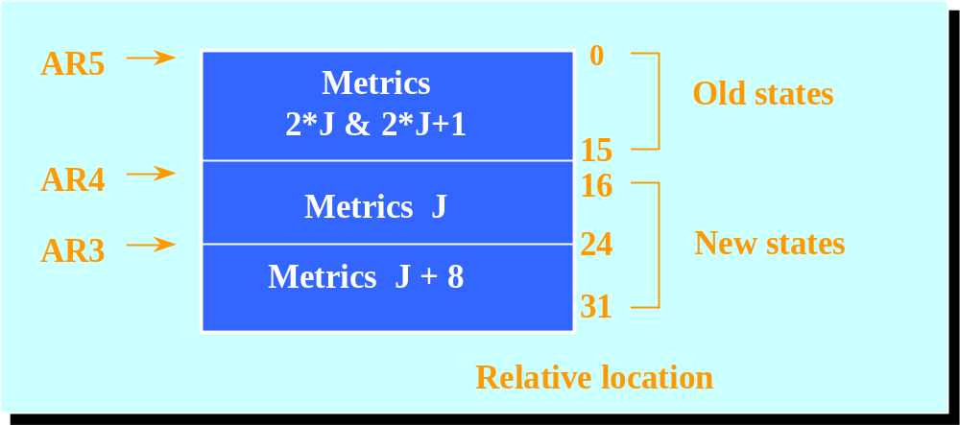
Viterbi Memory Map
AR2 points on local distance and
AR1 to buffer of Soft Decision bits SD0 and SD1

Slide 47
Metric Update Operations for 1 Symbol Interval with 16 States
Calculate local distance
  tmp(0)=diff, tmp(1)=sum
Load T register T=tmp(1)
Then 8 butterflies per symbol interval
  Direct butterflies = BFLY_DIR or
  Reverse butterflies = BFLY_REV
T is loaded with tmp(0)=diff after the 4th butterfly.

Slide 48
Code for the Metric Update in a Direct Butterfly
LD *AR2 T ;load d in T
DADST *AR5,A ;D_{2J}+d and D_{2J+1}-d
DSADT *AR5+,B ;D_{2J}-d and D_{2J+1}+d
CMPS A,*AR4+ ;compares the distances of
;the 2 paths arriving at J
;stores the best.TRN=TRN<<1.
;TRN(0)=1 if D_{2J}+M < D_{2J+1}-M,
;TRN(0)=0 if D_{2J}+M > D_{2J+1}-M
CMPS B,*AR3+ ;compares the distances of
;2 paths arriving at J+2^{(K-2),}
;stores the best.TRN=TRN<<1.
; TRN(0)=1 si D_{2J}-M < D_{2J+1}+M,
; TRN(0)=0 si D_{2J}-M > D_{2J+1}+M

Slide 49
Metric Update Operations (cont.)
1st butterfly BFLY_DIR
  New(0) = max(old(0)+sum, old(1)-sum)
  New(8) = max(old(0)-sum, old(1)+sum)
  TRN=xxxx xxxx xxxx xx08
2nd butterfly BFLY_REV
  New(1) = max(old(2)-sum, old(3)+sum)
  New(9) = max(old(2)+sum, old(3)-sum)
  TRN=xxxx xxxx xxxx 0819
3rd butterfly BFLY_DIR
  new(2), new (10) from old(4), old(5)
4th butterfly BFLY_REV
  new(3), new (11) from old(5), old(6)

Slide 50
Metric Update Operations (cont.)
Load T register T = tmp(0)
5 th butterfly BFLY_DIR
  new(4), new (12) from old(8), old(9)
6 th butterfly BFLY_REV
  new(5),new (13) from old(10),old(11)
7 th butterfly BFLY_DIR
  new(6),new (14) from old(12),old(13)
8th butterfly BFLY_REV
  new(7),new (15) from old(14),old(15)
Store TRN = 0819 2A3B 4C5D 6E7F

Slide 51
Metric Update Operations (cont.)
Update of metrics buffer pointers for next symbol interval :
  As metric buffers are set up in circular buffer, no overhead.
  Use *ARn+0% in the last butterfly (AR0 was initialized with 2^{(K-2)}+1 = 9
  Note long word incrementing Lmem: *ARn+
The transition data buffer pointer is incremented by 1 (each TRN is a 16-bit word)

Slide 52
VA Traceback Function
Trace the maximum likelihood path backward through the trellis to obtain N bits.
Final state known (by insertion of tail bits in the emitter) or estimated (best final metric).
In the transition buffer :
  1 = previous state is the lower path
  0 = previous state is the upper path
Previous state is obtained by shifting transition value in the LSB of the state
Time t
TRN bit
Time t+1
State 2J
b3
b2
b1
0
0
b3
b2
b1
State J
State 2J+1
b3
b2
b1
1
1
b3
b2
b1
State J+8

Slide 53
VA Traceback Function (cont.)
The data sequence is obtained from the reconstructed sequence of states. (MSB).
The data sequence is (often) in reversed order.

Slide 54
VA Traceback Function (cont.)
Transition Data Buffer
The transition data buffer has:
  2^{K-5} transition words for each symbol interval.
  For N trellis stages or symbol intervals, there are N 2^{K-5} words in the transition data buffer.
  For GSM, 2^{K-5} = 1.
Stored transition data are scrambled.
E.g. GSM, 1 trans. Word/stage, state ordering:
  (MSB) 0819 2A3B 4C5D 6E7F (LSB)
Calculate position of the current state in the transition data buffer for each symbol interval.

Slide 55
VA Traceback: Find the Word to Read in the Transition Data Buffer
For a given node j at time t, find the correct transition word and the correct bit in that word.
  For the GSM example there is only 1 transition word per symbol interval.
  In the general case, there are 2^{K-5} transition words and if the state number is written in binary:
    j = b_{K-2} … b₃ b₂ b₁ b_{0,}
    The number of the transition word for node j is obtained by setting MSB of j to 0 and shifting the result 3 bits to the right.
    Trn_Word_number(j) = b_{K-2} … b₄ b_{3,}

Slide 56
VA Traceback: Find Bit to read in the Correct Word of the Transition Data Buffer
Find the number of the correct bit in the transition word.
    Number 0 = MSB, number 15 = LSB.
If state number j = b_{K-2} b₃ b₂ b₁ b₀ in binary,
  Bit number (Bit#) in the in the transition word is:
  Bit # = b₃ b₂ b₁ b₀ b_{K-2} (for the GSM example)
  Bit# = 2 x state +(state >> (K-2))&1
  Bit# = 2 x state + MSB(state)
This bit number (in fact 15-Bit#) is loaded in T for next step.

Slide 57
VA Traceback: Determine Preceding Node
Read and test selected bit to determine the state in the preceding symbol interval t-1,
  Instruction BITT copy this bit in TC.
  Set up Address in the transition buffer for next iteration.
Instruction BITT (Test Bit Specified by T)
  Tests bit n° 15-T(3-0)
Update node value with new bit
  New state obtained with inst. ROLTC:
  ROLTC shifts ACCU 1 bit left and shifts TC bit into the ACCU LSB.
  So if j = b_{K-2} b₃ b₂ b₁ and transition bit = TC
    The precedent node has number: b₃ b₂ b₁ TC (for GSM)

Slide 58
VA Traceback Function (cont.)
Traceback algorithm is implemented in a loop of 16 steps
  The single decoded bits are packed in 16-bits words
Bit reverse ordering

Slide 59
VA Traceback Routine
A = state value
B = tmp storage
K = constraint length
MASK = 2^{(K-5)}-1
ONE=1
Final state is assumed to be 0
AR2 points on the transition data buffer
TRANS_END=end address of trans. buffer
AR3 points on the output bit buffer
OUTPUT = address of the output bit buffer
NBWORDS = Nb of words of output buffer packed by packs of 16 bits.

Slide 60
VA Traceback Routine: Initialization
RSBX OVM
STM #TRANS_END,AR2
STM #NBWORDS-1,AR1
MVMM AR1, AR4
STM #OUTPUT+NBWORD-1,AR3
LD #0,A
;init state = 0 here
STM #15,BRC
;for loop i

Slide 61
VA Traceback Routine (cont.)
back RPTB TBEND-1
;loop j=1 to 16
SFTL A,-(K-2),B
AND ONE,B
ADD A,1,B ;add MSB
STLM B,T ;T=bit pos
MAR *+AR2(-2^(K-5))
BITT *AR2
ROLTC A
TBEND STL A,*AR3-
BANZD BACK,*AR1-
STM #15,BRC ; end i

Slide 62
VA Traceback Routine: Reverse Order of Bits
MAR *AR3+ ; start output
LD *AR3, A
RVS SFTA A,-1,A ;A>>1, C=A(0)
STM #15,BRC
RPTB RVS2-1
ROL B ;B<<1, B(0)=C
SFTA A,-1,A ;A>>1, C=A(0)
RSV2 BANZD RVS,*AR4-
STL B,*AR3+ ;save compl. word
LD *AR3,A ;load next word

Slide 63
Additional Resources
H. Hendrix, “Viterbi Decoding Techniques on the TMS320C54x Family”, Texas-Instruments spra071.pdf, June 1996.
Internet: Search on “Tutorial on Convolutional Coding with Viterbi Decoding”.

